Slide 1
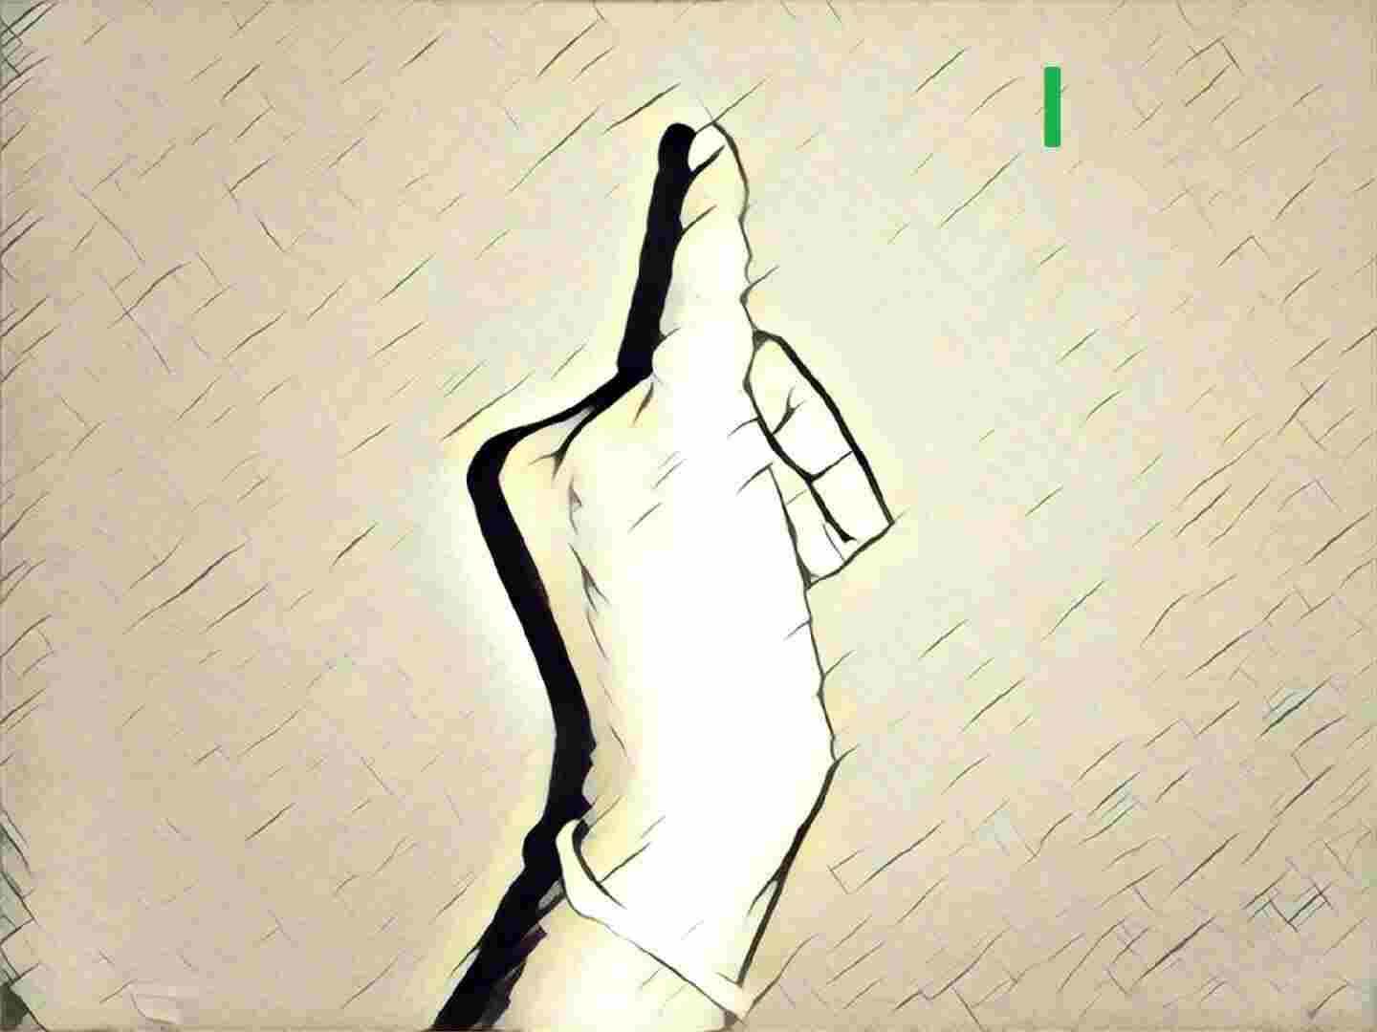
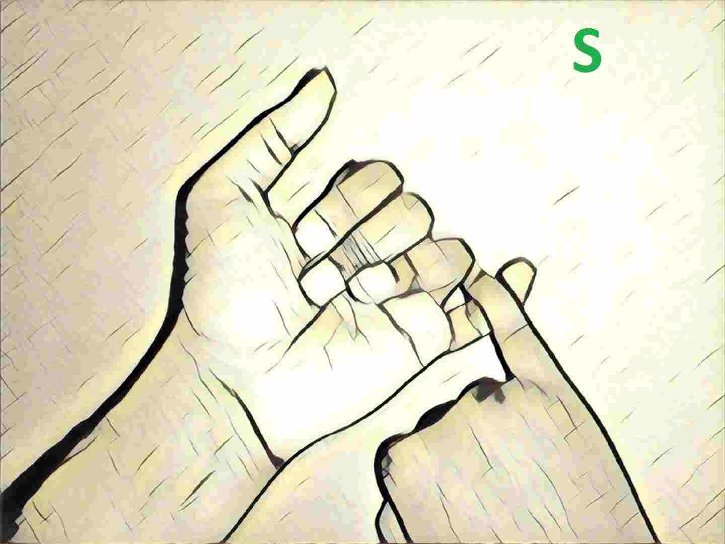
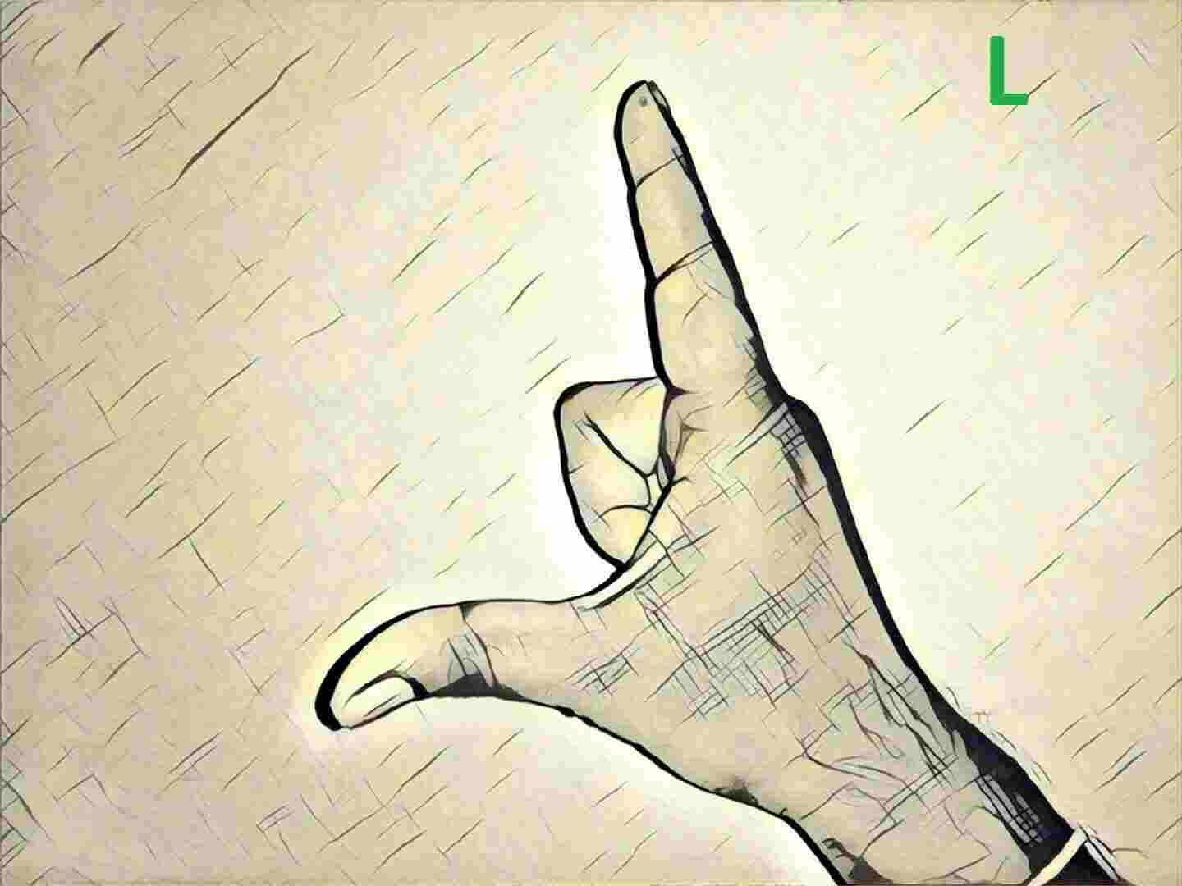
INTERPRETER
Team Members:
Harish Fegade
Akshay Nimbalkar
Raviraj Dixit
Sangeeth Kumar

Slide 2
Problem Statement
The deaf community takes all the efforts to communicate with the society. In reality only few experts can understand the sign language and interpret it to hearing people.
Deaf community are deprived of employment opportunities due lack of understanding of sign language by the hearing people.
The main objective of our project is to translate sign language to speech.
The aim is to provide a helping-hand for speech-impaired to communicate with rest of the world using sign language.
Everyone cannot have a personal interpreter for understanding the sign language, we intend to develop an app that every deaf as well as hearing person should have in order to interact with one another.

Slide 3
Research Methodology
Today, much of the research work has been done in gesture recognition and sign language recognition for ASL (American Sign Language).
Research works carried out in ISL (Indian Sign Language) using image processing/vision techniques but limiting upto classification only. The challenge is non-availability of standard datasets and usage of two hands in ISL that leads to occlusion of features in the dataset, when compared to ASL.
We are in touch with two deaf schools in Mumbai and few more leads provided by them.

Slide 4
Data Source
Images
https://www.talkinghands.co.in/
https://drive.google.com/open?id=1wgXtF6QHKBuXRx3qxuf-o6aOmN87t8G-
https://www.handspeak.com/word/
Videos
https://www.youtube.com/playlist?list=PLEU1orBCyhvZkbAgeWlnyU3rl5o8ovUOm
https://www.youtube.com/playlist?list=PLEU1orBCyhva3FVfLBl_EqgcRxFXbslRW
Real life data to be collected from schools and studios.
AYJ school for deaf, Bandra.
Hashu Advani College Of Special Education

Slide 5
Deployment
Create an app using android platform. OR
Create a website.

Slide 6
Project Timelines
Milestones | Start date | Finish date | Grading
Define a problem | 10-03-2019 | 04-04-2019 | 5%
Get the Data | 25-03-2019 | 30-04-2019 | 5%
Explore and pre-process data | 25-03-2019 | 30-04-2019 | 10%
Create Features | 25-03-2019 | 30-04-2019 | 5%
Create Model | 04-04-2019 | 31-05-2019 | 15%
Deploy & consume model | 01-05-2019 | 31-05-2019 | 10%
Report Writing | 01-05-2019 | 10-06-2019 | 10%
Project submission | 13-06-2019 | 13-06-2019 | 15%
Final presentation with project/ product demonstration | 13-06-2019 | 13-06-2019 | 20%
Blog publishing | 10-06-2019 | 10-06-2019 | 5%

